Slide 1

Team Name : AI Smart Drone
Team Leader Name : MAKESH K
Problem Statement : Manual drone filming is complex, expensive, and inefficient. Tracking a single subject in crowded or dynamic environments is difficult, leading to multiple retakes, high production costs, and privacy concerns due to unintended recording of bystanders.

Slide 2

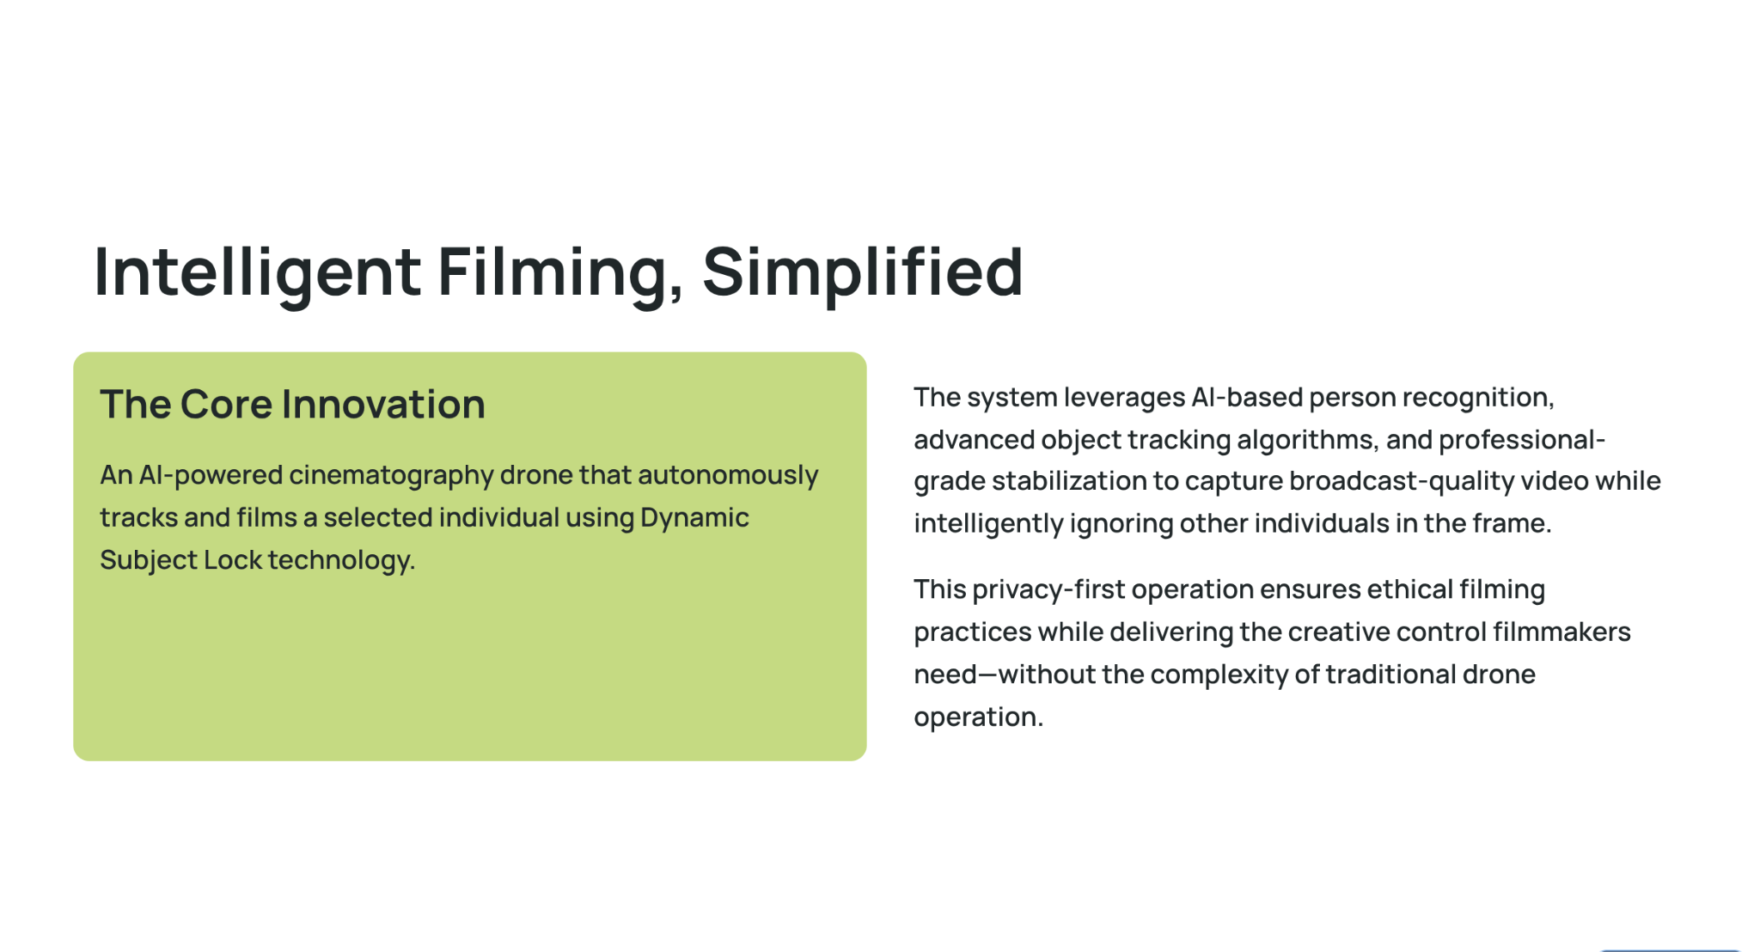

Slide 3
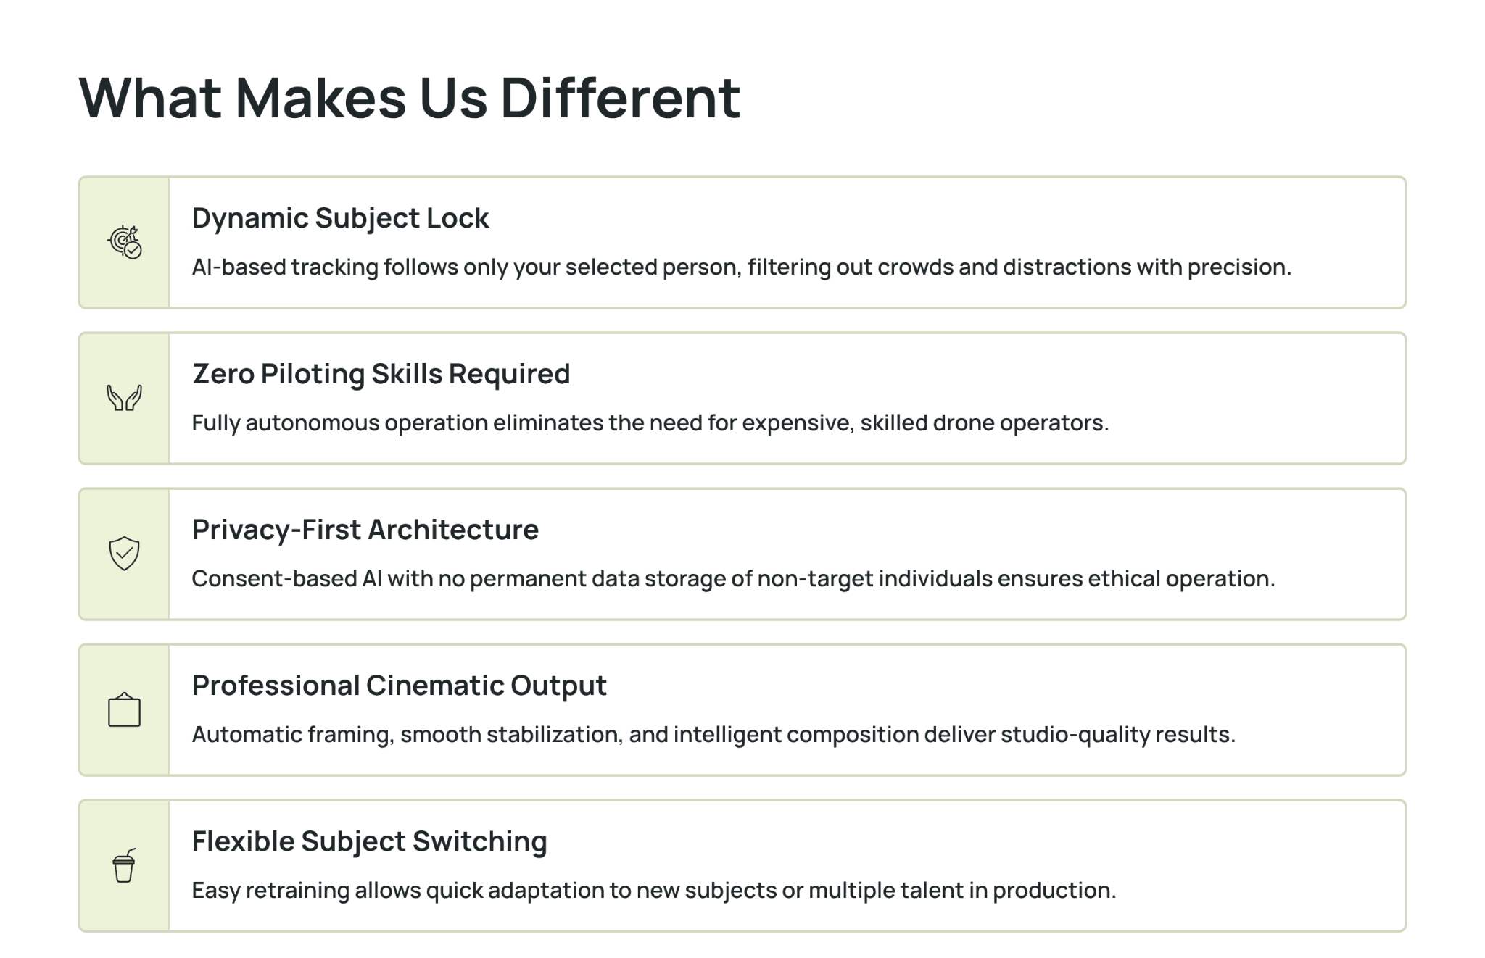

Slide 4
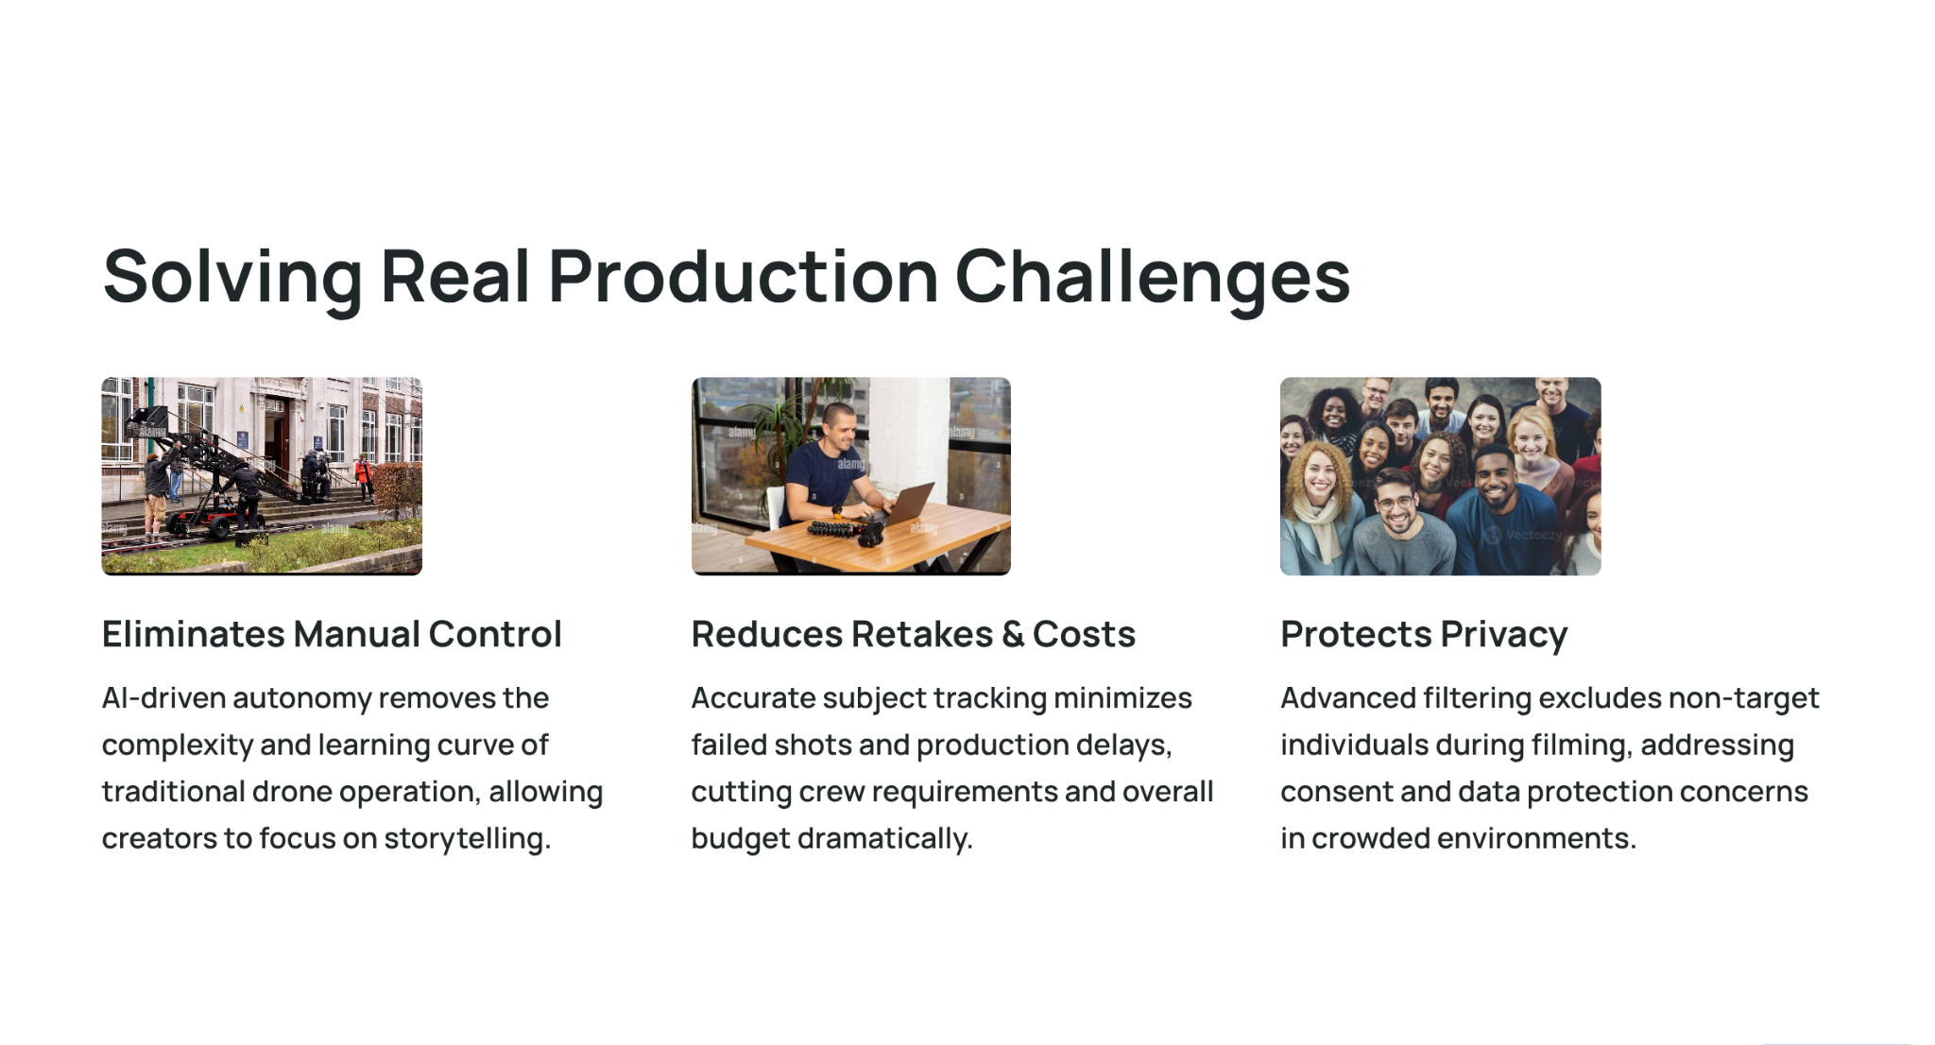

Slide 5
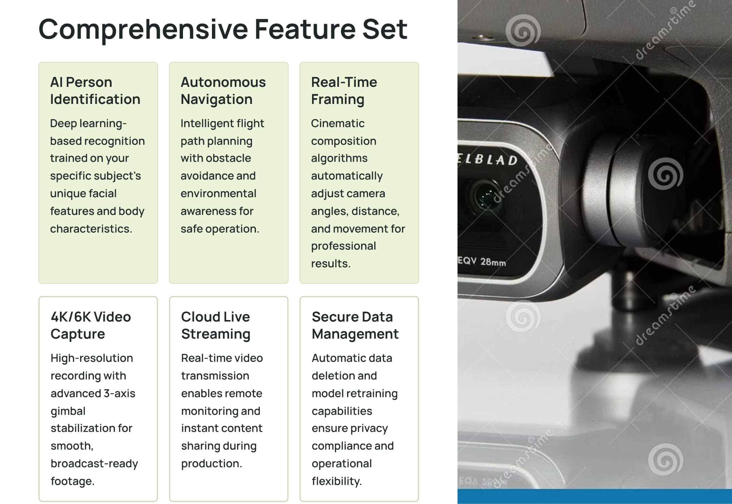

Slide 6
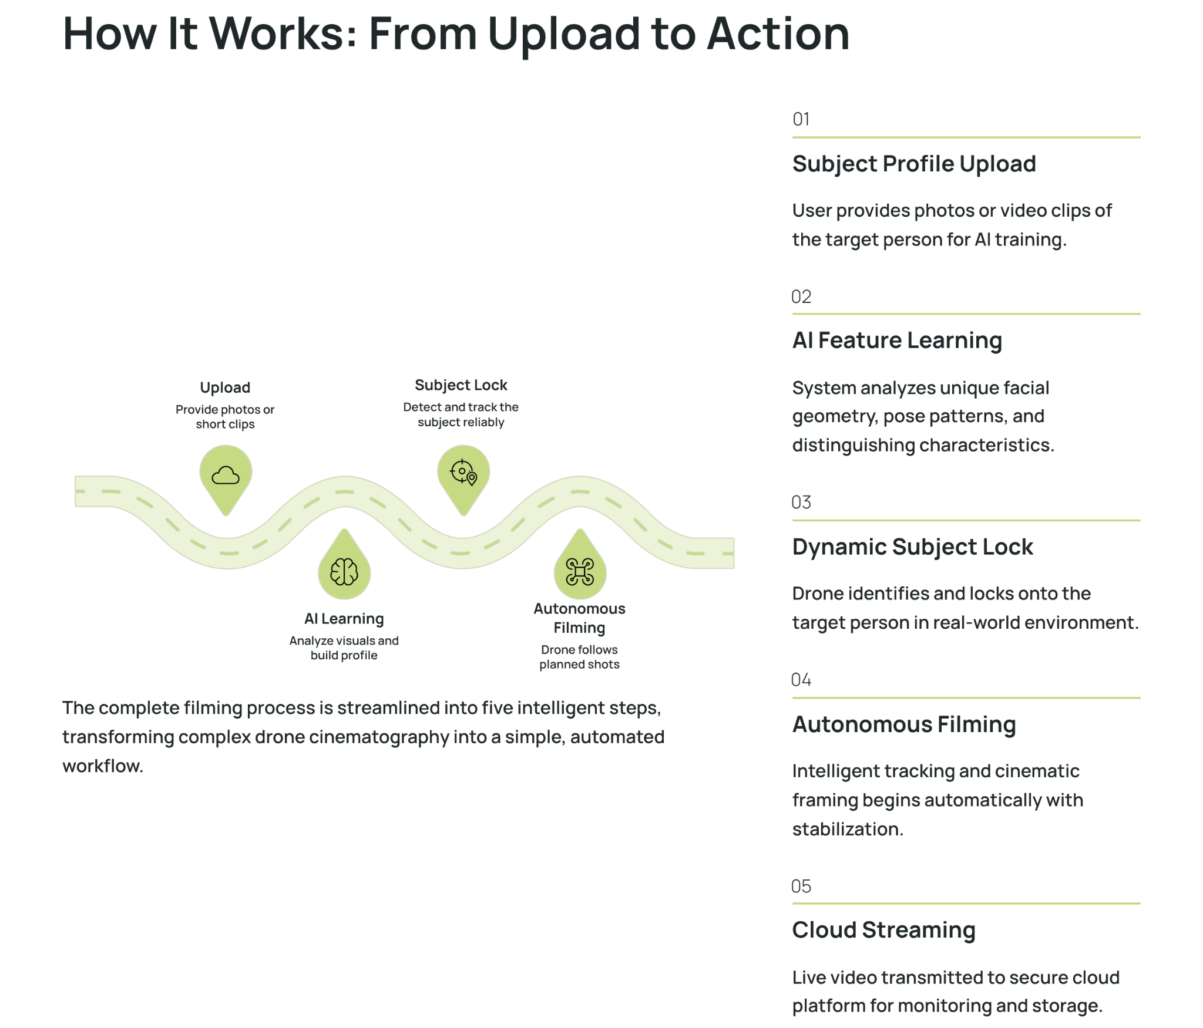

Slide 7
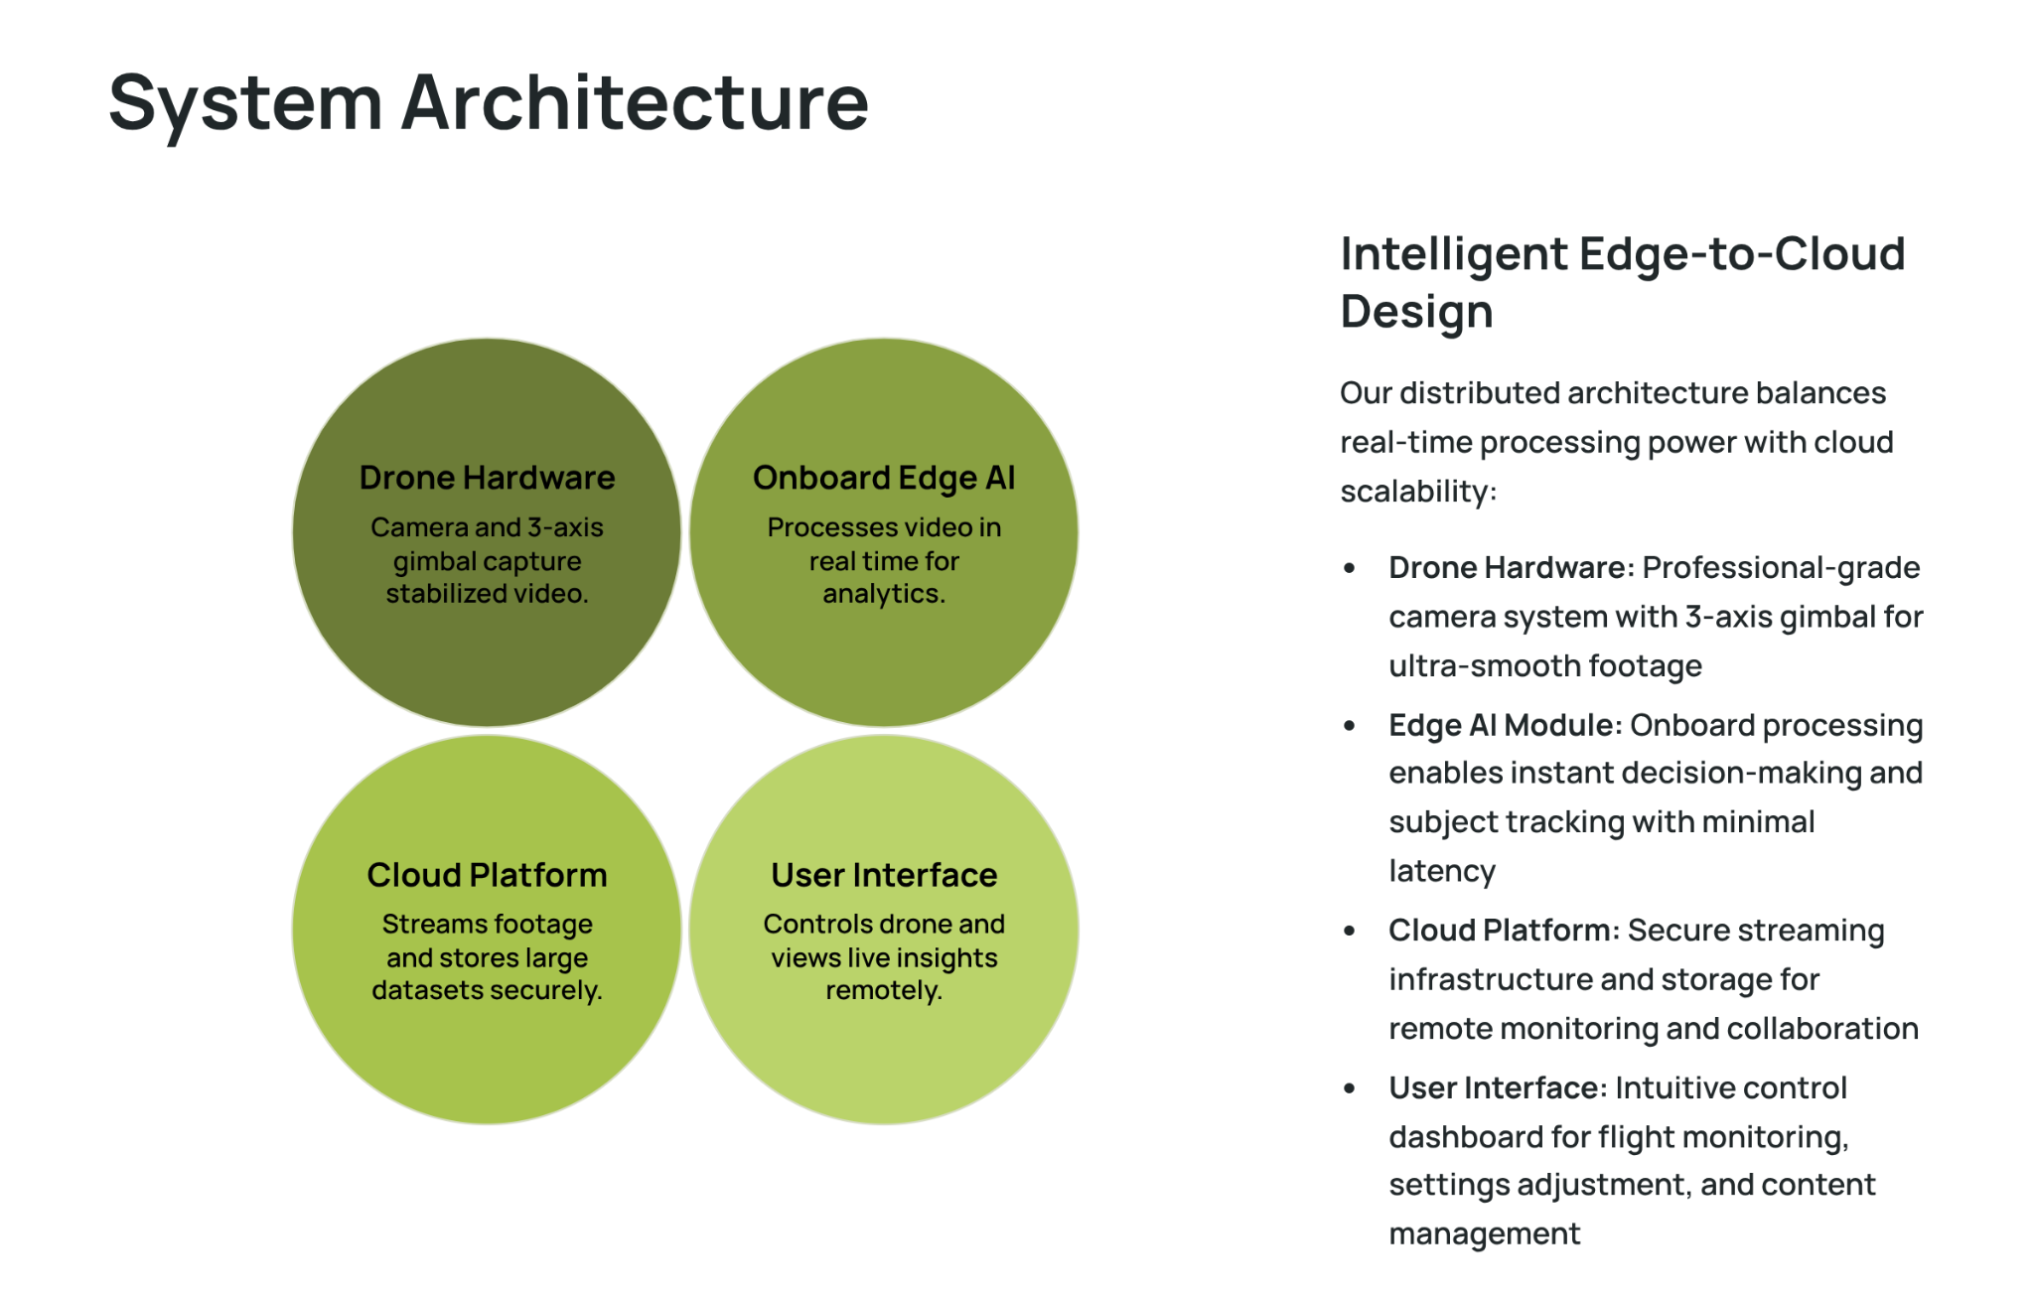

Slide 8
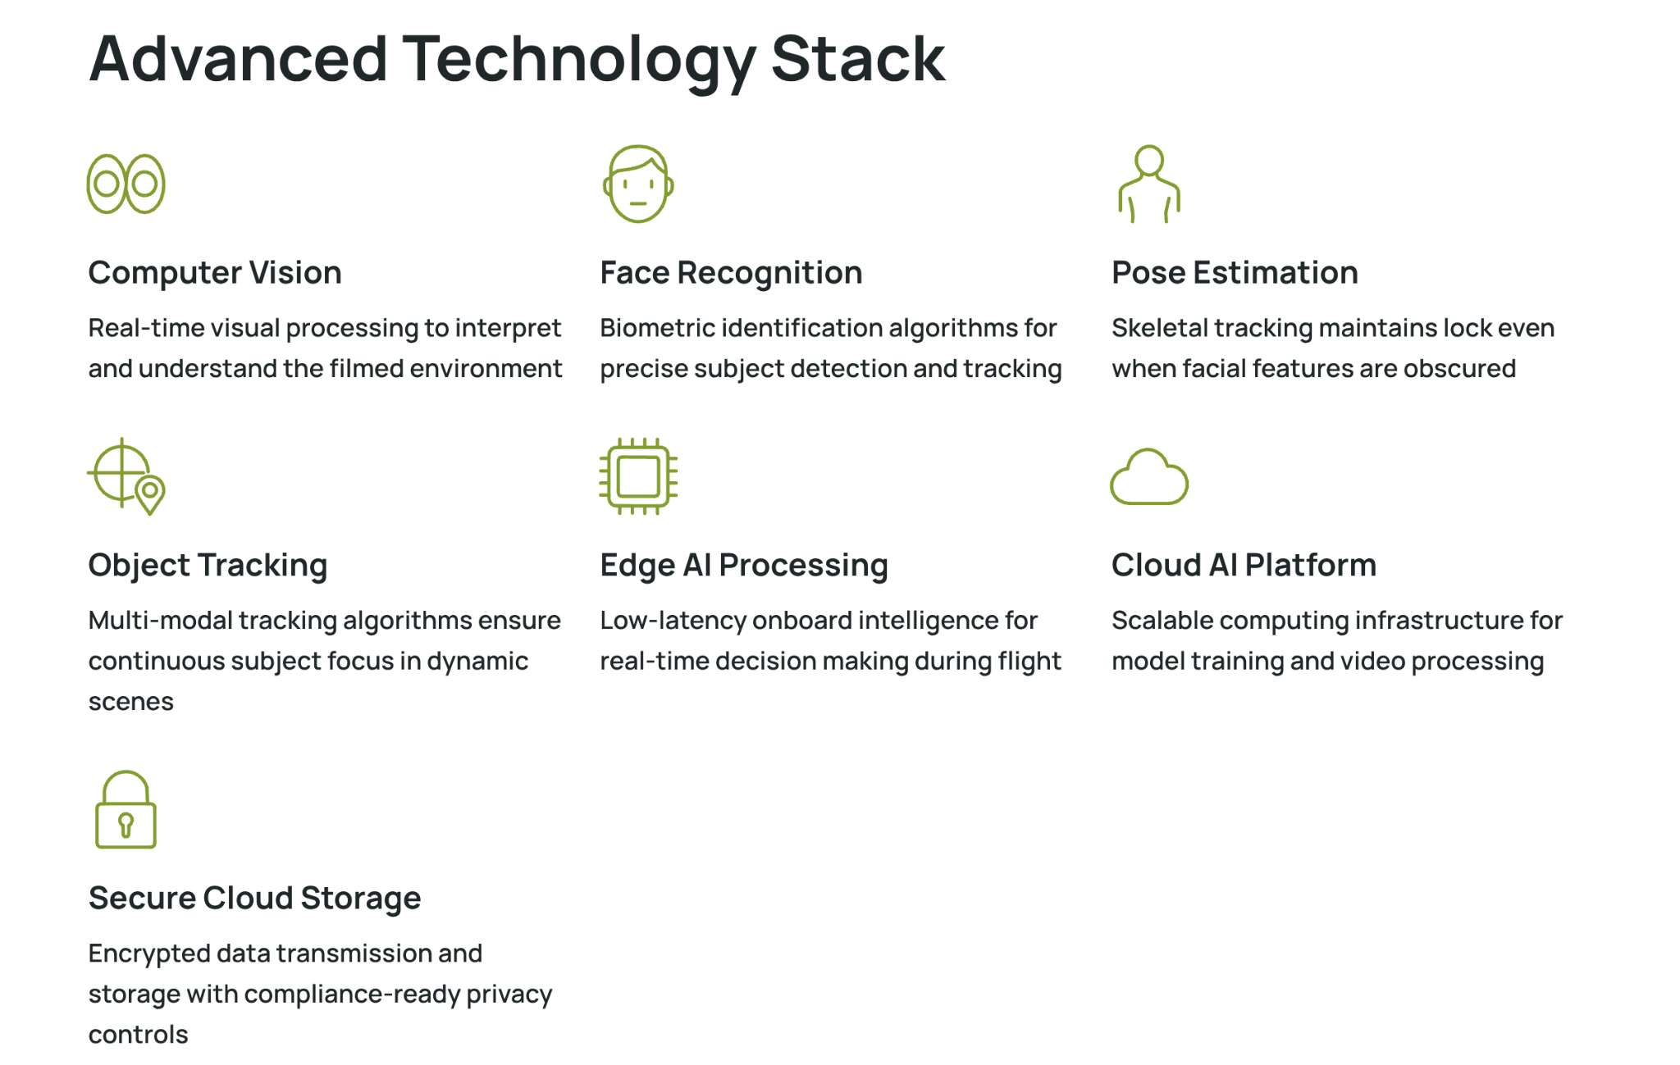

Slide 9
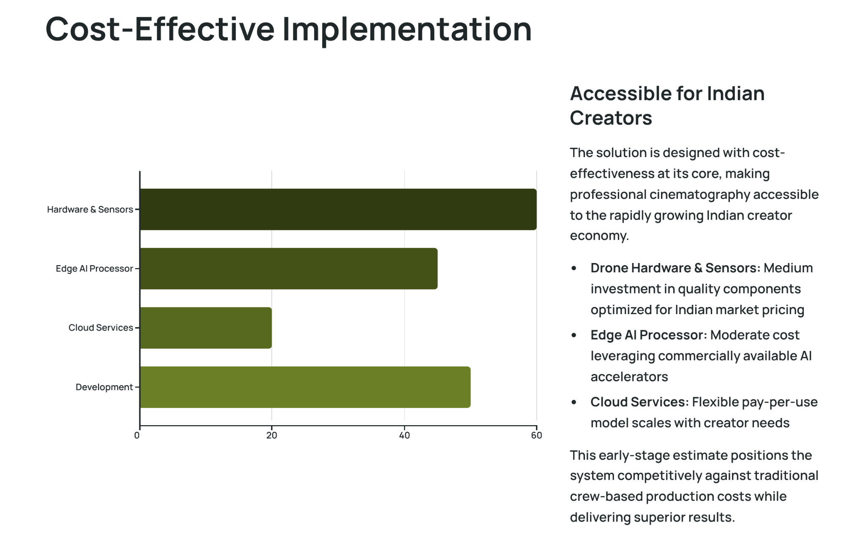

Slide 10
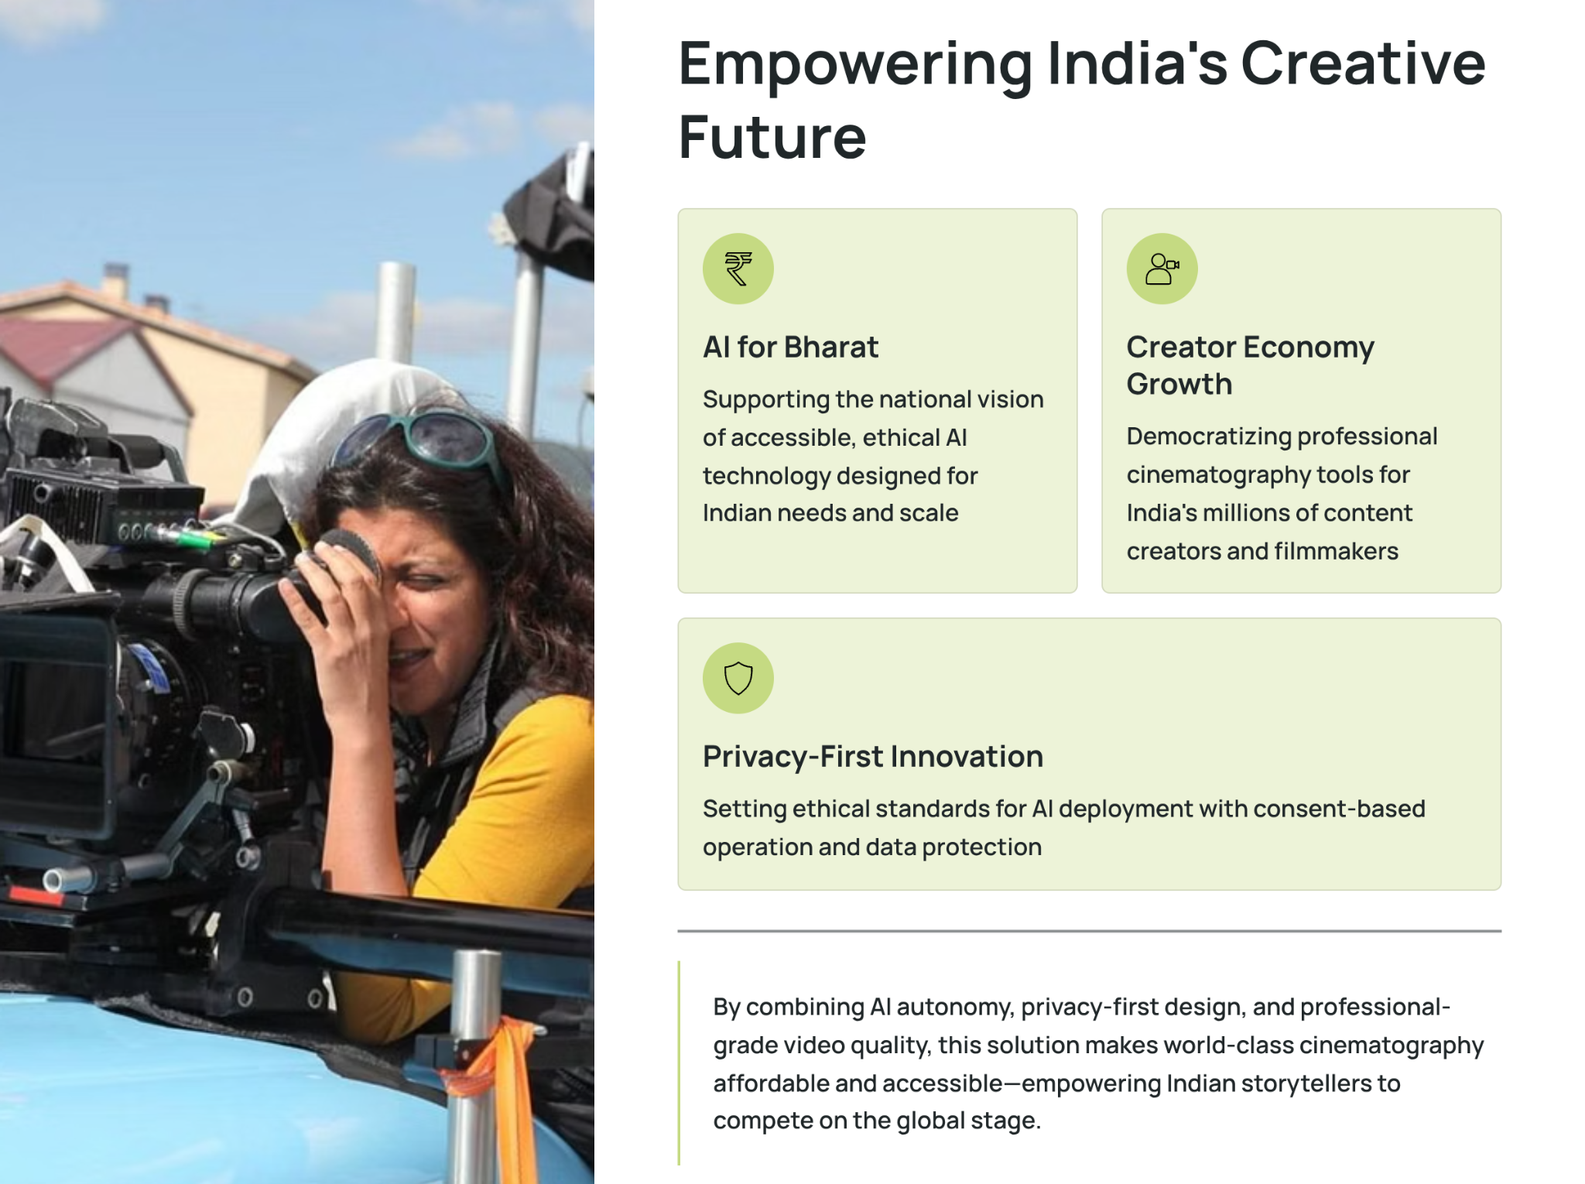

Slide 11


